Slide 1
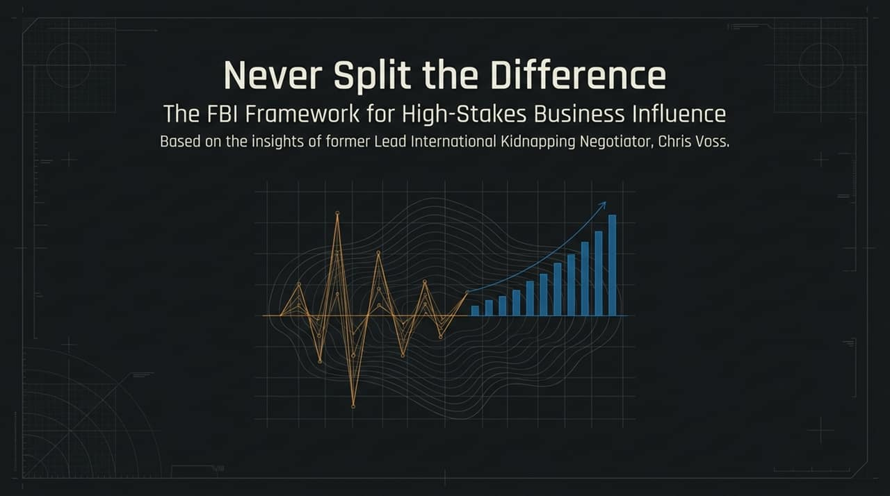
Notes:
Introduction: Welcome everyone. Today, we’re unpacking a high-stakes influence framework derived from former FBI Lead International Kidnapping Negotiator Chris Voss, author of Never Split the Difference.
Core Premise: At first glance, kidnapping negotiations and modern business deals seem worlds apart. But whether you're negotiating for a hostage or negotiating an M&A deal, funding round, or commercial agreement, you are dealing with human beings under pressure.
Key Takeaway: Negotiation isn't an academic exercise or a battle of spreadsheets; it is a psychological process rooted in human biology. Today, we'll examine how to leverage emotional intelligence to turn adversaries into genuine collaborators.
https://www.youtube.com/watch?v=fTJklJp75Is

Slide 2
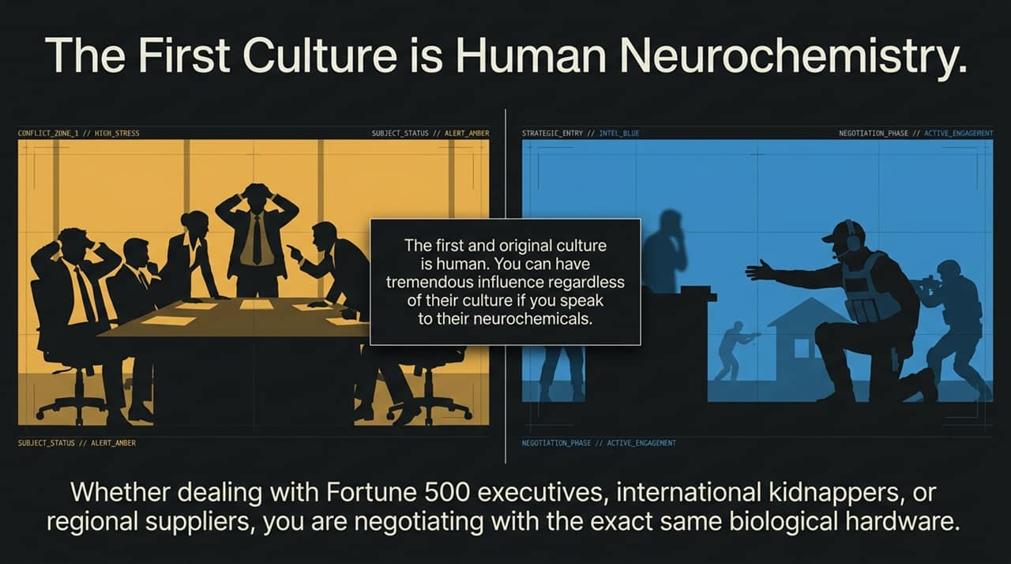
Notes:
Universal Hardware: In international deal-making, people often get bogged down by regional etiquette—whether doing business in Dubai, Monaco, Singapore, or New York. While superficial customs vary, human neurochemistry is identical across every geography, ethnicity, and culture.
The Archetypes: Whether facing Fortune 500 executives, international kidnappers, or regional suppliers, you are negotiating with the exact same biological hardware.
Biological Decision Making: High pressure triggers universal fear mechanisms. If you speak directly to these underlying neurochemical drivers, you gain immense influence regardless of the counterpart's background.
Actionable Insight: Do not get lost in procedural rules or surface-level differences. Focus first on addressing human neurochemistry—releasing emotional pressure to restore clear, rational thinking.

Slide 3
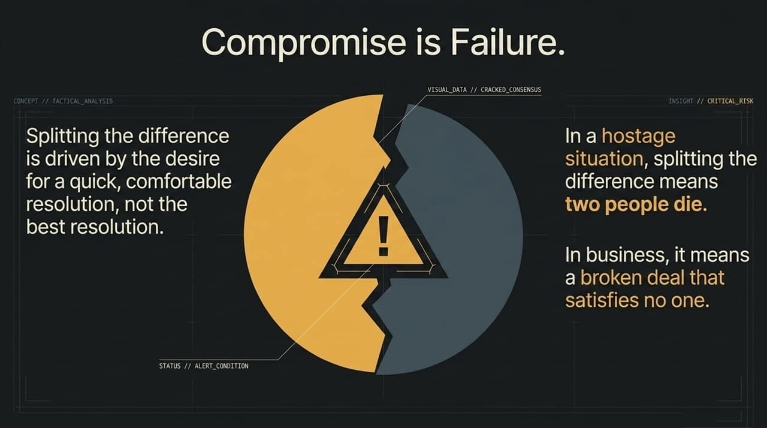
Notes:
The Fallacy of "Win-Win": In traditional business, we are taught that compromise is the ultimate goal—that meeting halfway is a victory. Voss challenges this directly: Splitting the difference is failure.
Hostage vs. Business Context: In hostage negotiation, splitting the difference between six hostages and zero means three people die. In business, splitting the difference leads to split-the-difference, half-baked compromises that satisfy neither party and result in broken implementation down the road.
Why We Compromise: Compromise is rarely driven by a desire for the best outcome; it is driven by a desire for a comfortable, quick resolution to avoid conflict.
Actionable Insight: Stop rushing to split numbers or make lazy concessions just to conclude a meeting. Push past superficial compromises to unearth the true drivers of the deal.

Slide 4
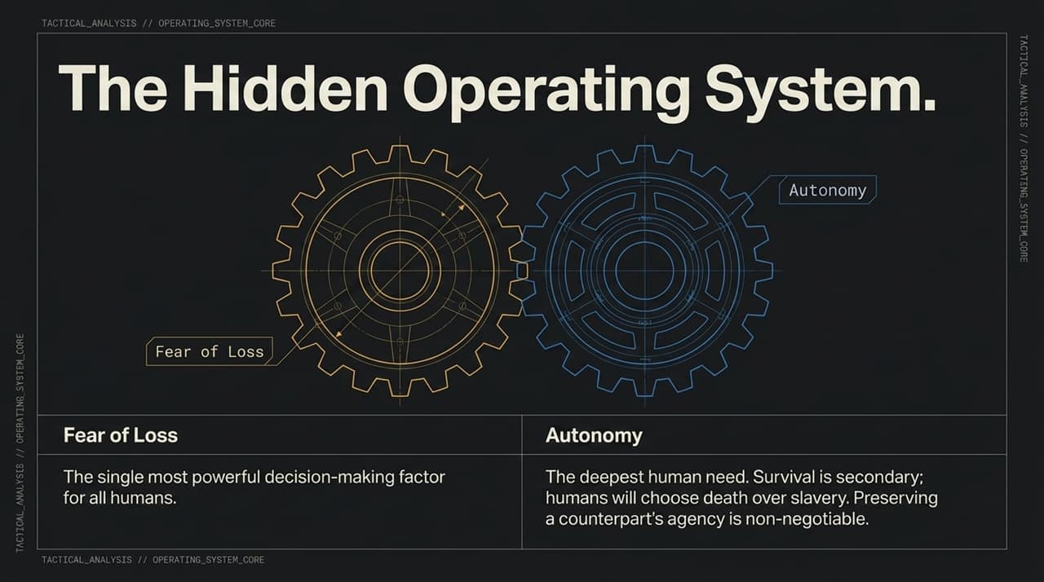
Notes:
Two Core Drives: Human decision-making is governed by two underlying gears: Fear of Loss and Autonomy.
1. Fear of Loss: Fear of loss is the single greatest driver of human choice. People are far more motivated to avoid a loss than they are to gain an equal reward. Short-term panic and negative emotions dictate how people react under pressure.
2. Autonomy: Contrary to Maslow's hierarchy, autonomy—not basic survival—is the deepest human need. Throughout history, humans have repeatedly chosen death over slavery ("Give me liberty or give me death").
Mandela Example: Nelson Mandela survived decades in prison by realizing that because suicide is a choice, staying alive in prison was his own autonomous decision.
Actionable Insight: If a counterpart feels cornered, they will resist instinctively, even against their own economic interest. Preserving their agency is non-negotiable.

Slide 5
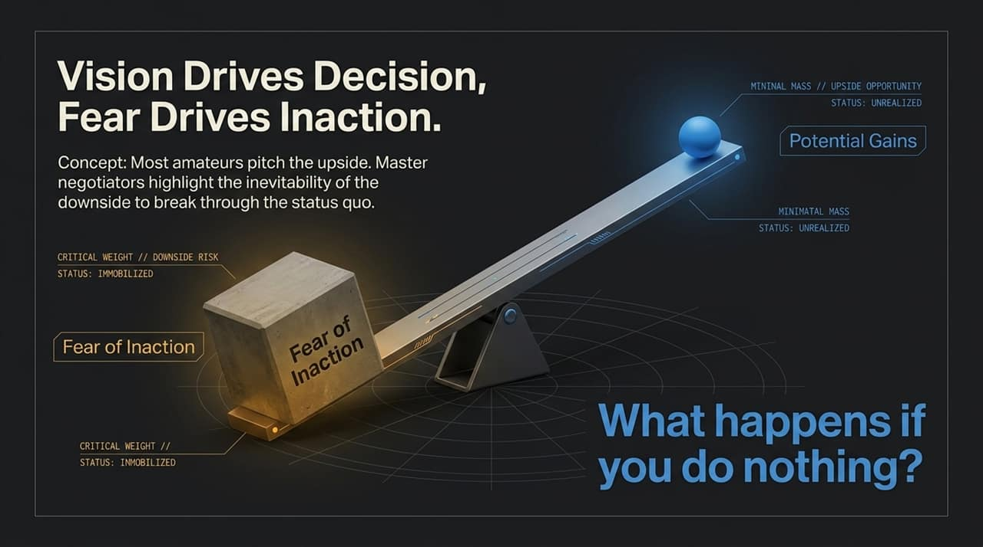
Notes:
Pitching Upside vs. Downside: Amateurs pitch features, benefits, and upside potential. Master negotiators highlight the downside risk of doing nothing to break through the status quo.
The Power of Inaction: In business, the biggest competitor isn't another vendor—it's inaction driven by fear of making a mistake.
The Diagnostic Question: Ask your counterpart: "What happens if you do nothing?"
Psychological Shift: This question forces them to confront the inevitable cost of inaction, bringing their fear of loss into sharp focus and unlocking immobilized decision-making.

Slide 6
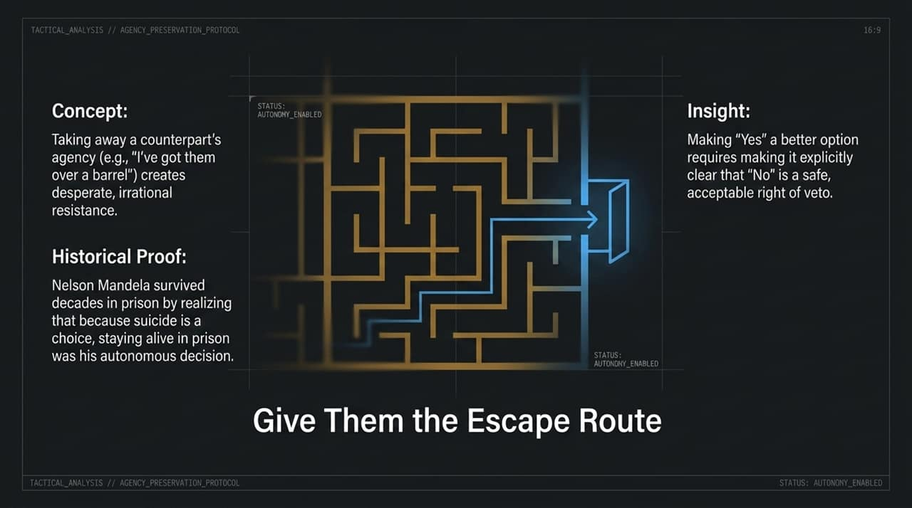
Notes:
The Cornered Trap: Sayings like "I've got them over a barrel" indicate a fatal negotiation flaw. When you strip someone of their agency, you trigger desperate, irrational resistance.
Safe Right of Veto: To make a "Yes" attractive, you must make it clear that saying "No" is completely safe. Giving them a clear escape route paradoxically makes them more willing to walk down the path with you.
Actionable Insight: Always grant your counterpart the absolute right of veto. When people realize they aren't trapped, their defensive guard drops, opening the floor for real collaboration.

Slide 7
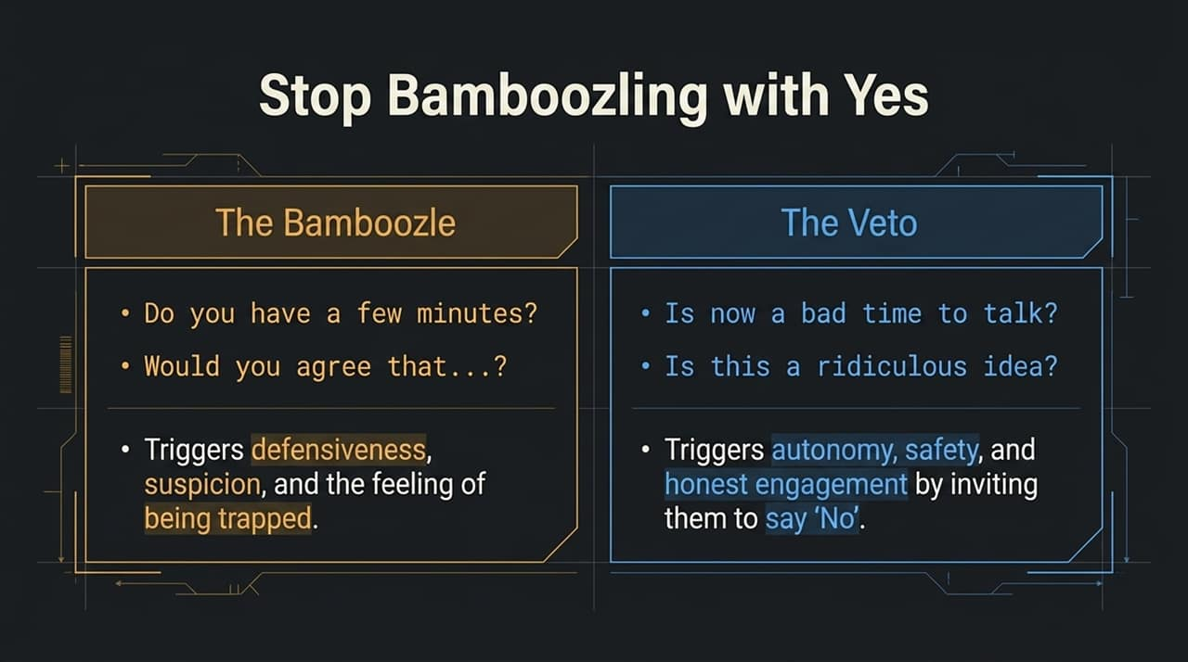
Notes:
The "Yes" Trap: Traditional sales techniques teach us to force micro-agreements: "Do you have a few minutes?" or "Would you agree that...?" This triggers immediate defensiveness, suspicion, and the feeling of being trapped or "bamboozled".
Flitting to "No": Shift your questions to invite a "No" answer.
Instead of "Do you have a few minutes?" ask: "Is now a bad time to talk?"
Instead of "Is this a good fit?" ask: "Is this a ridiculous idea?" or "Are you against this?"
Psychological Impact: Saying "No" gives the counterpart a sense of safety, autonomy, and control. From that safe ground, they can give you honest, actionable engagement.

Slide 8
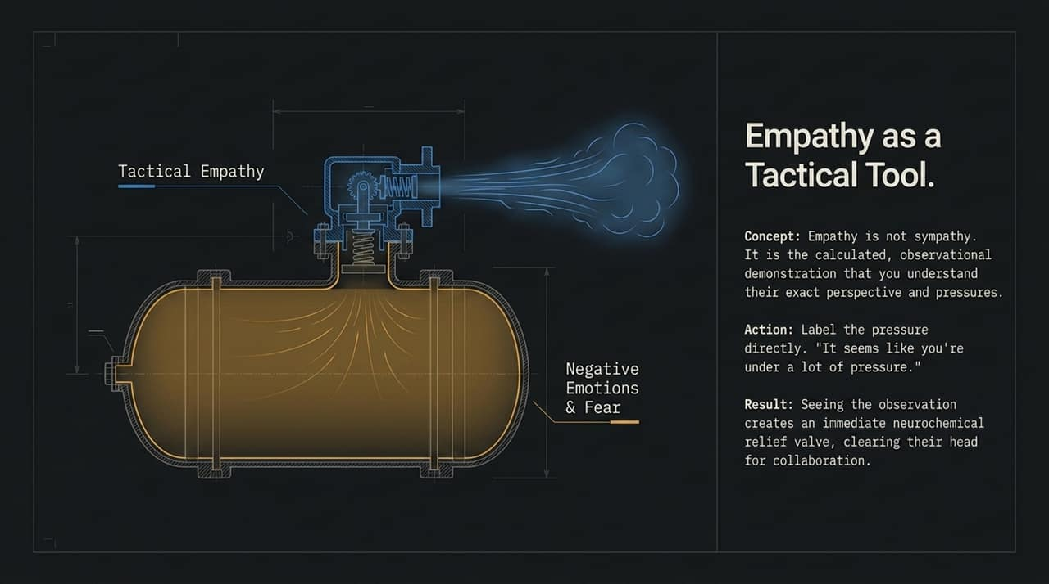
Notes:
Empathy vs. Sympathy: Tactical empathy is not being soft or agreeing with the counterpart. It is the calculated, observational demonstration that you understand their exact perspective, pressures, and constraints.
Labeling the Pressure: Use labels to call out their unspoken stress: "It seems like you're under a lot of pressure," or "It seems like you have a strict timeline."
Neurochemical Relief Valve: Labeling acts like a release valve on a pressure tank. Once their negative emotions are named, their prefrontal cortex reactivates, clearing their head for genuine collaboration.

Slide 9
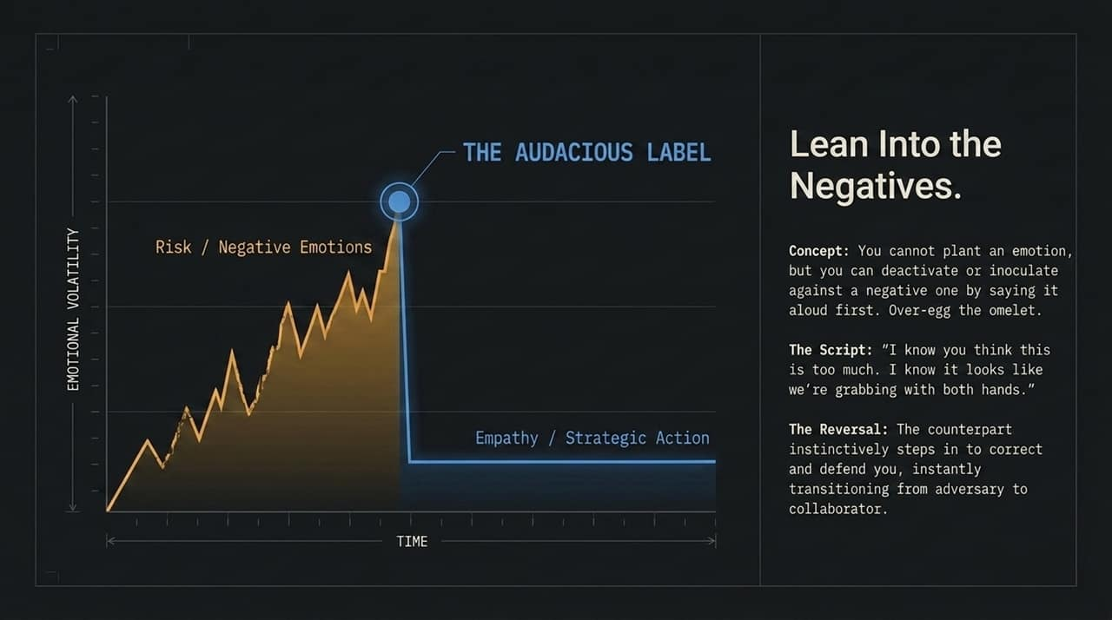
Notes:
Inoculate & Deactivate: You cannot plant a new negative emotion, but you can deactivate or inoculate against existing ones by saying them aloud first.
"Over-Egging the Omelet": Go to the extreme in calling out their worst thoughts about you.
Scripting Example: "I know you think this price is ridiculous. You probably feel like we're greedy vultures swooping in to take advantage of you."
The Reversal Effect: When you deliberately overstate the negative, the counterpart's natural instinct is to correct you: "No, no, you're being too hard on yourself. It's just that our budget is tight." In that moment, they shift from an adversary to a mentor/collaborator.

Slide 10
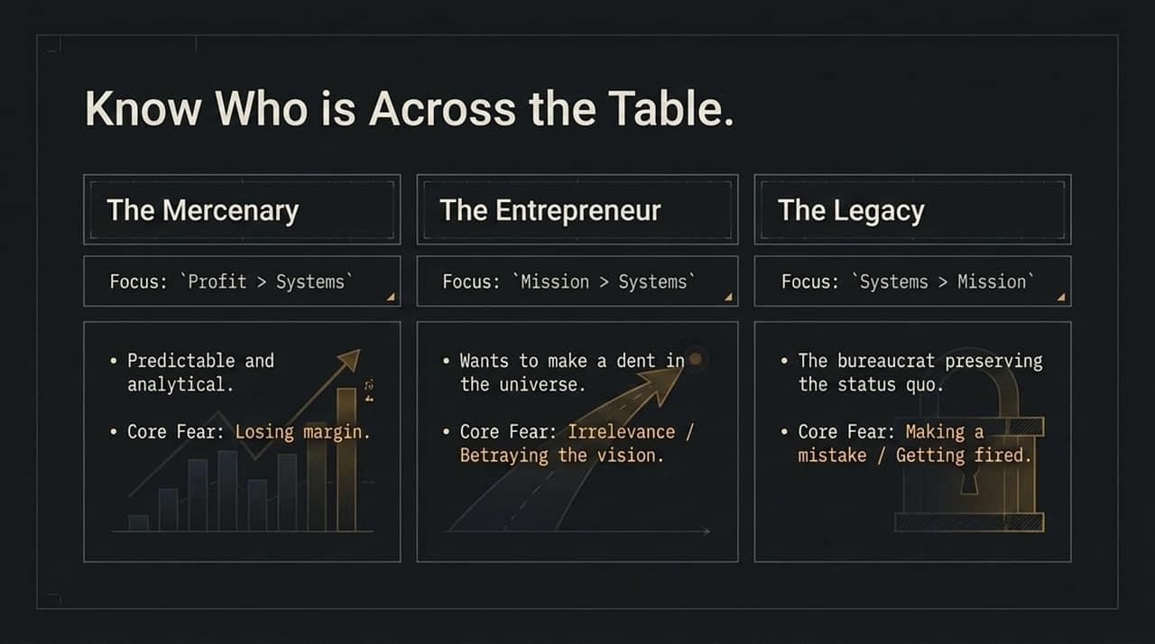
Notes:
Identify the Archetype: Every negotiator falls into one of three primary archetypes, each with distinct priorities and fears:
1. The Mercenary: Focuses on Profit > Systems > Mission. Highly analytical and predictable. Core Fear: Losing margin or profit.
2. The Entrepreneur: Focuses on Mission > Systems > Profit. Driven to build something great and make a dent in the universe. Core Fear: Irrelevance or betraying their vision.
3. The Legacy: Focuses on Systems > Mission > Profit. Typically a bureaucrat or corporate executive maintaining the status quo. Core Fear: Making a mistake, looking foolish, or getting fired.
Actionable Insight: Tailor your tactical empathy to target the specific core fear of the archetype you face.

Slide 11
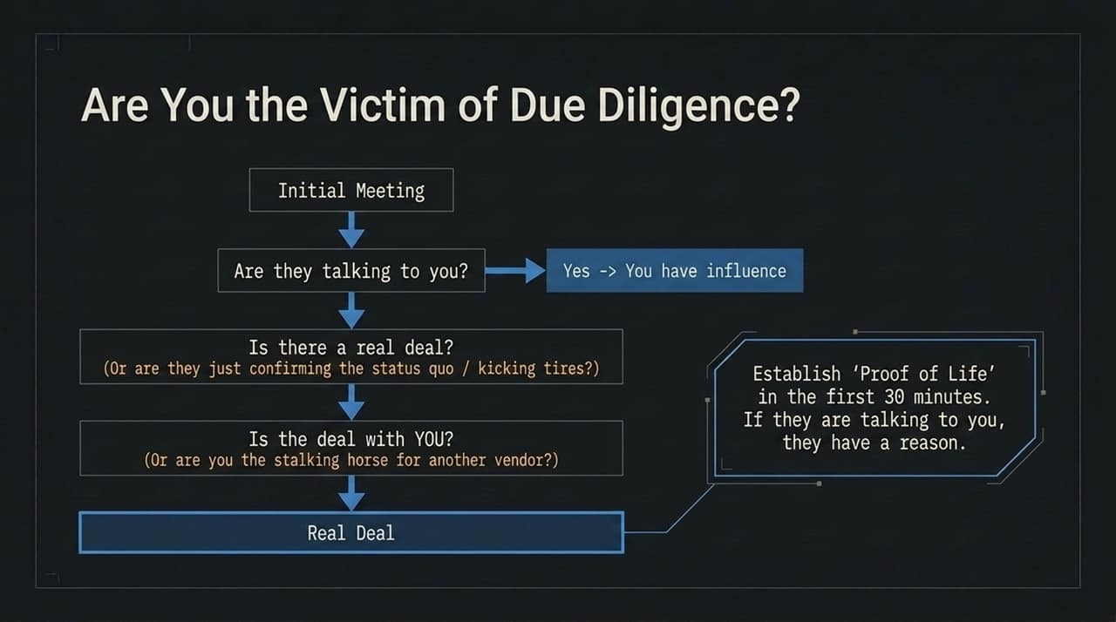
Notes:
Wasted Energy: In business, counterparties often spend hours talking to you without any intention of closing a deal.
Three Critical Questions: Within the first 30 minutes of engagement, establish "Proof of Life" by assessing:
Are they talking to you? (If yes, you have influence).
Is there a real deal? (Or are they just validating the status quo?)
Is the deal with YOU? (Or are you just a stalking horse used to beat down a competitor's price?)
Actionable Insight: If there is no real deal or they are just kicking tires, walk away early to preserve your resources.

Slide 12
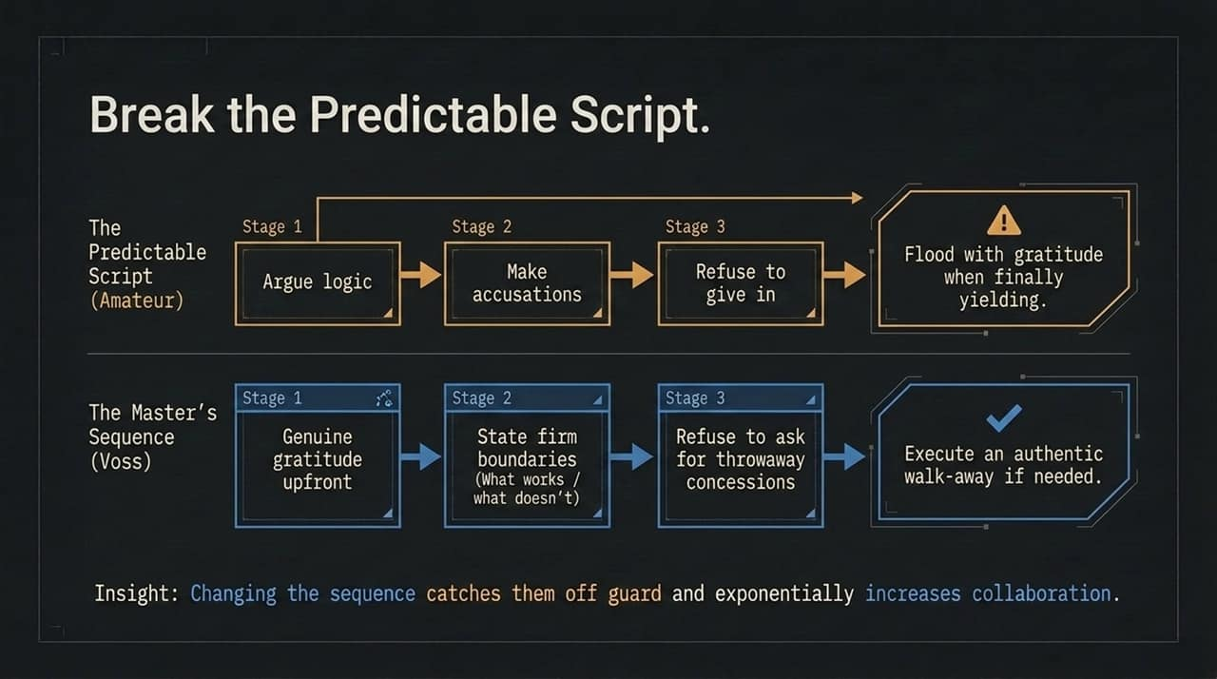
Notes:
The Amateur Script: Amateurs follow a predictable pattern: Argue logic $→$Make accusations $→$Refuse to give in $→$Flood with fake gratitude when yielding. Counterparts expect this and prepare defenses accordingly.
The Master's Sequence (Voss):
Stage 1: Express genuine gratitude upfront for the opportunity to talk.
Stage 2: State firm boundaries around what works and what doesn't work for you.
Stage 3: Refuse to ask for or give throwaway concessions.
The Outcome: Disrupting their expected script catches them off-guard, eliminates game-playing, and dramatically increases collaborative problem-solving.

Slide 13
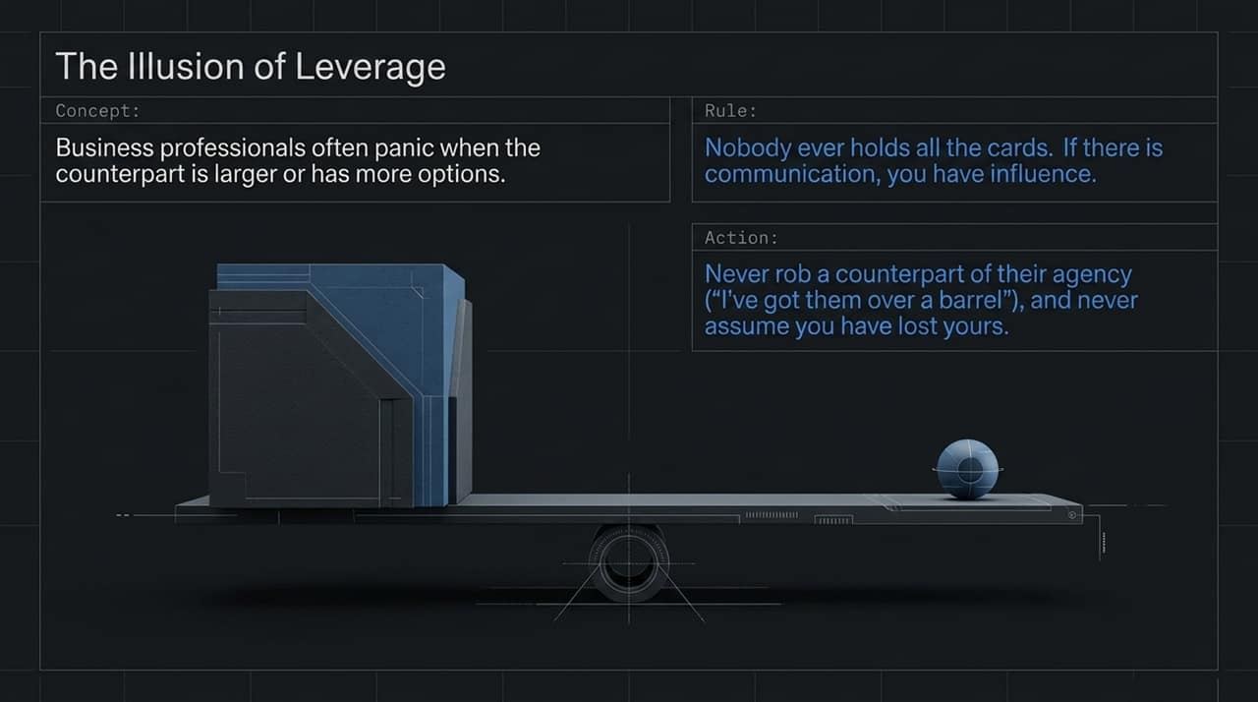
Notes:
Panicking Over Scale: Negotiators often freeze up when facing a larger corporate counterpart or an opponent with more options.
The Fundamental Rule: Nobody ever holds all the cards. If they are spending time talking to you, you have influence.
Actionable Insight: Never assume you have lost leverage, and never try to strip the counterpart of theirs. Leverage is an illusion; focus instead on understanding their internal pressures and timelines to guide the conversation.

Slide 14
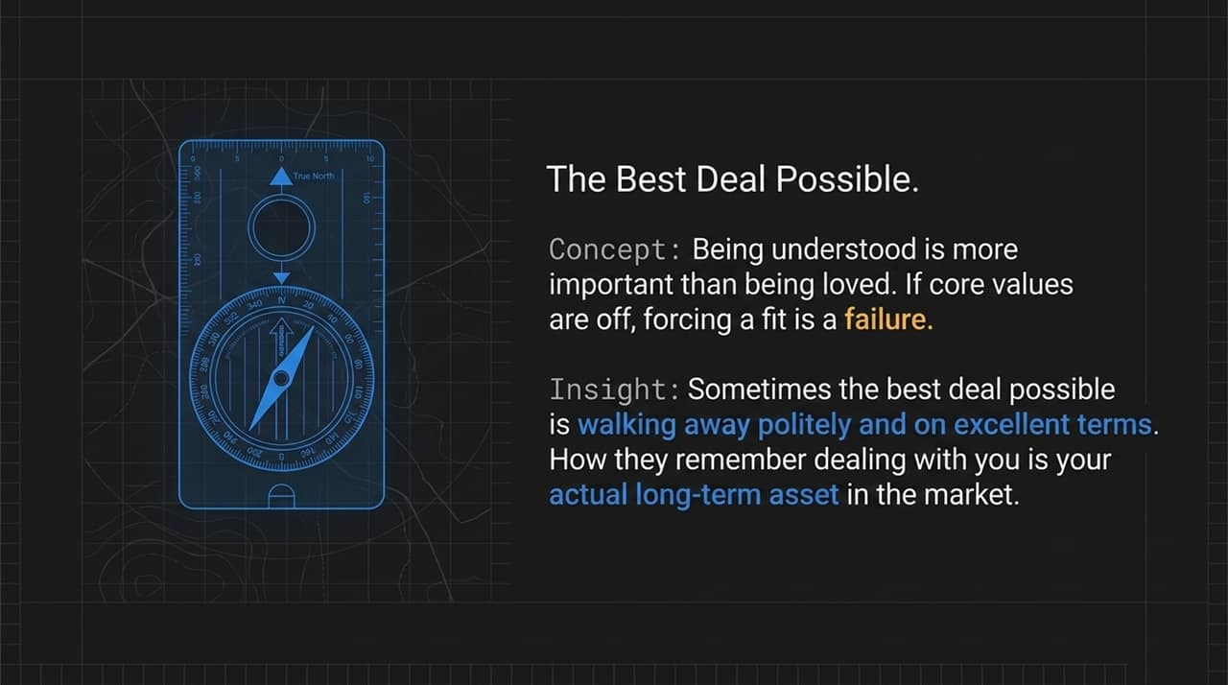
Notes:
Understanding Over Affection: Being understood is far more powerful than being liked.
Core Value Alignment: If core values don't align, forcing a deal is a long-term failure.
The Clean Walk-Away: Sometimes the single best deal possible is a polite, early walk-away on excellent terms.
Long-Term Asset: How counterparties remember dealing with you becomes your most valuable long-term asset in the marketplace. A polite "no deal" today often leads to high-value deals tomorrow.

Slide 15
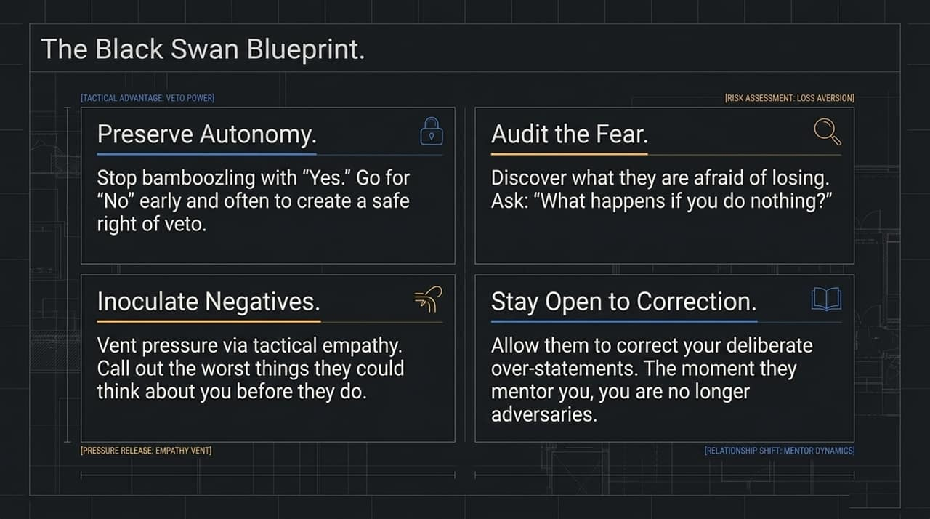
Notes:
Framework Summary: Reviewing our key core operating principles:
Preserve Autonomy: Trigger "No" early to give them a safe right of veto.
Inoculate Negatives: Use tactical empathy and audacious labels to vent pressure.
Audit the Fear: Discover loss aversion by asking "What happens if you do nothing?"
Stay Open to Correction: Allow them to mentor and correct your deliberate over-statements.
Execution: Master these elements to predictably convert high-stress conflicts into lucrative, long-term business partnerships.

Slide 16
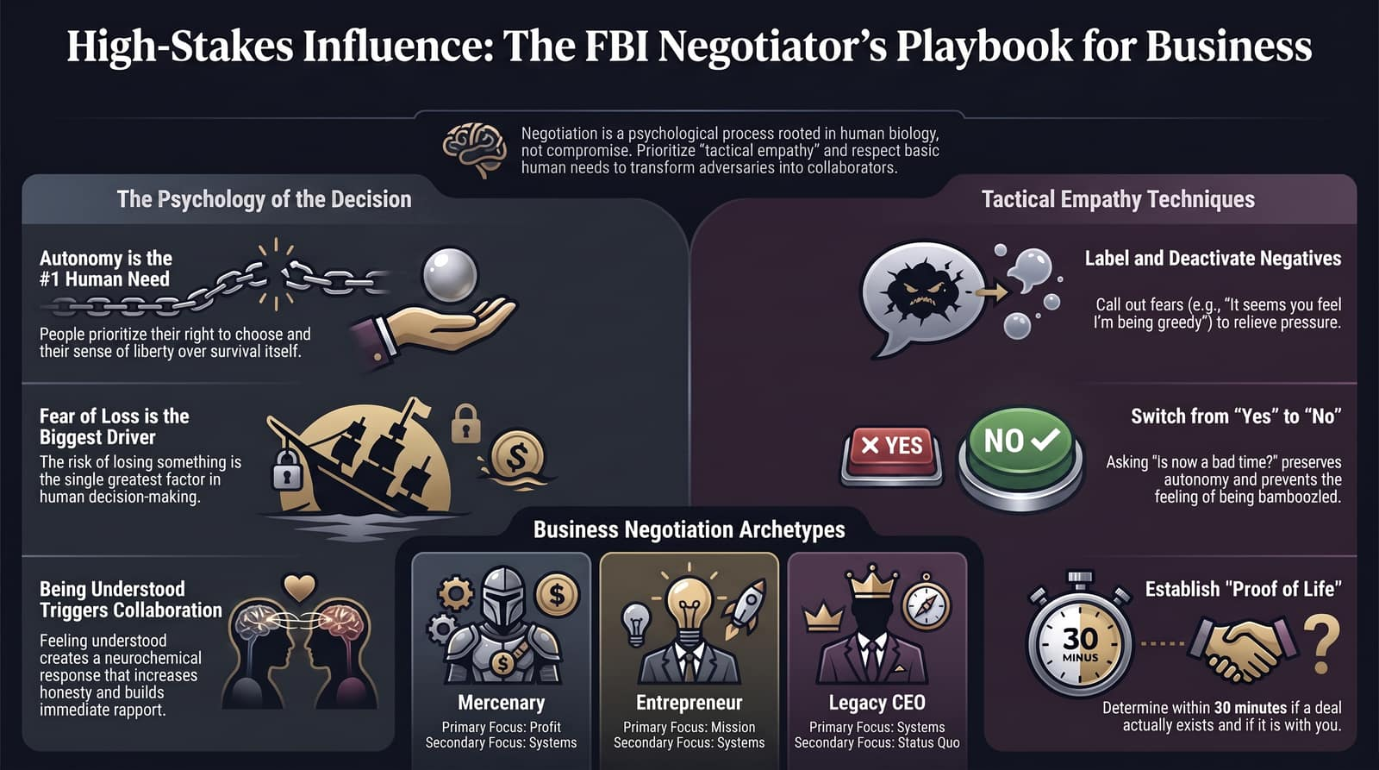
Notes:
Final Wrap-Up: This summary cheat sheet brings together our entire discussion:
Respect Autonomy as the #1 human need.
Address Fear of Loss as the ultimate decision driver.
Utilize Tactical Empathy to trigger neurochemical rapport.
Identify buyer Archetypes (Mercenary, Entrepreneur, Legacy).
Establish Proof of Life within 30 minutes.
Closing Note: Shift from pushing for a quick "Yes" to uncovering deeper truths. You will execute faster, build better relationships, and close better deals.

